Slide 1

Senior Design
https://github.com/powermad80/web-rubric

Slide 2


Group Member Information
Team
Hannah Dubusker (CS) – hannahdubusker@gmail.com
Rohan Kapoor (CS) – kapoorrn@mail.uc.edu
Advisor
Dr. Xuefu(Frank) Zhou – zhoxu@ucmail.uc.edu

Slide 3


Goals
To develop a web application that will present the instructor(s) with a dynamic user-interface to allow them to:
Import and edit senior design project rubric
Import and view enrolled student’s information from UC Canvas
Fill out the imported rubric and assign grades to students

Slide 4

Intellectual Merits
Our application offers a rubric editor and creator for grading rubrics and allows uploading of properly formatted rubric documents in the form of Excel spreadsheets.
Interacts with Canvas and Catalyst provided data, to streamline the adding of student information.

Slide 5

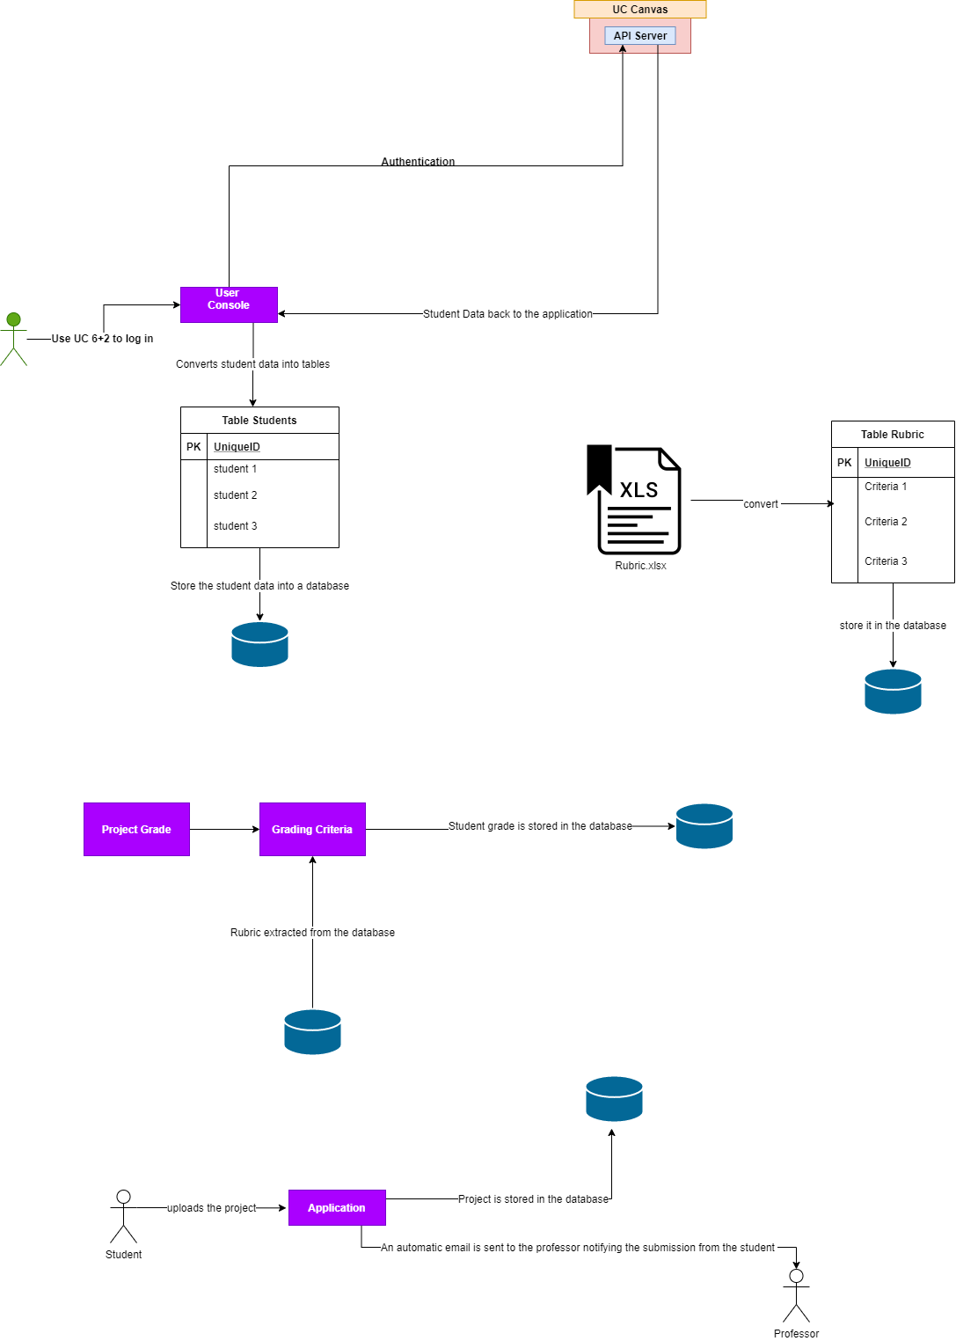
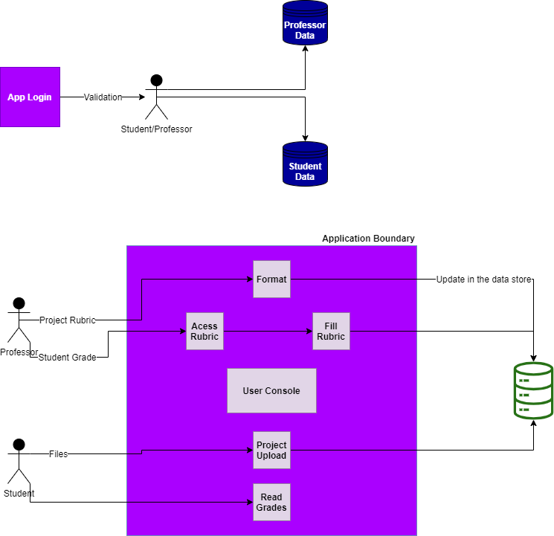
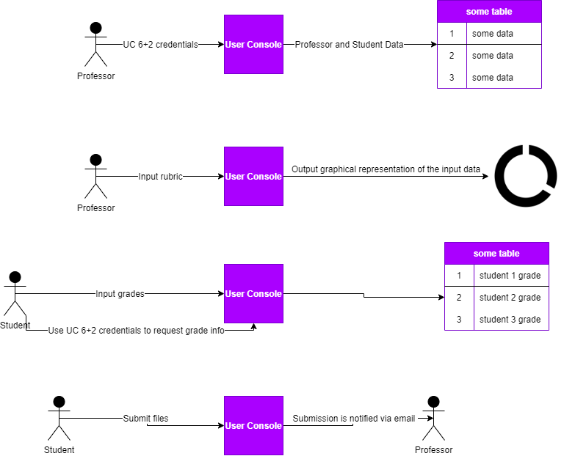
Design Diagrams

Slide 6

Understanding System Design
As a professor, I want to upload my student lists to the website so that I can easily manage info related to them and their projects.
As a professor, I want to log into the website from any computer and see the info pertaining to my class and students, so that I can securely manage their information.
As a professor, I want to upload my project rubric to the website so that I can interact with and make changes to it.
As a professor, I want to fill out and assign scores based on the rubric I have uploaded to students, based on the criteria in the rubric.

Slide 7
Technologies
DOTNET (.NET)
.NET Framework is a software framework developed by Microsoft that runs primarily on Microsoft Windows.
It includes a large class library called Framework Class Library and provides language interoperability across several programming languages.
React.js
React is an open-source, front end, JavaScript library for building user interfaces or UI components.
It is maintained by Facebook and a community of individual developers and companies.
In this project, React introduces a new paradigm of state management and rendering for our web application.
OAuth
OAuth is an open standard for access delegation, commonly used as a way for Internet users to grant websites or applications access to their information on other websites but without giving them the passwords.
In this project, OAuth tokens will be used to access Canvas and import relevant data/files.

Slide 8
Milestones
Timeline
Task | Contributor(s) | Start Date | End Date
Functional Login Page | Dubusker & Kapoor | 6-Jan-21 | 15-Jan-21
Professor landing page | Dubusker | 15-Jan-21 | 22-Jan-21
Rubric Upload and View | Dubusker & Kapoor | 22-Jan-21 | 18-Feb-21
Rubric Edit | Dubusker & Kapoor | 18-Feb-21 | 28-Feb-21
Rubric from-fill | Dubusker & Kapoor | 1-Mar-21 | 15-Mar-21
Project is divided into 5 tasks
Each task will be worked on a defined time frame with varying contributions from the team members.

Slide 9

Results
Feature 1: Instructor's ability to import, parse and edit rubric from local system’ directory
Feature 2: Instructor’s ability to import enrolled student’s list from UC Canvas
Feature 3: Instructor's ability to assign grades to respective students

Slide 10
Challenges
Integrating UC Canvas API with the web-app to import enrolled student’ information.
Developing an in-app rubric editor to import and parse a MS-Excel based rubric.

